Slide 1

Regain Abdominal Strength & Control
Presenter: Bruce LaBrecque RN, PT

Slide 2
Who Provides Pelvic Abdominal PT to Perinatal Patients
There are a growing number of PTs promoting Women’s Health or Pelvic Health PT treatment. When seeking out care providers, it is important that patients make sure that the therapist they are seeing actually practices in a manner that recognizes perinatal patients have special needs. Some “Women’s Health” PTs advocate that perinatal patients can & should be seen by any therapist including PTs with little or no specialized training in the unique needs/considerations that are important in rendering appropriate Women’s Health care to the perinatal patient.

Slide 3
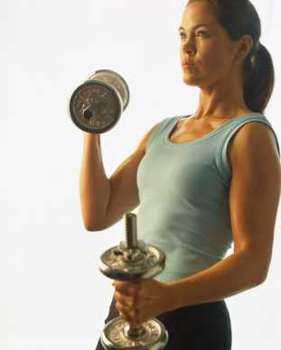
Objectives
understand common abdominal,
pelvic & postural problems
related to weakness or pain
following pregnancy
learn how to successfully
manage and/or resolve those
functionally limiting issues
learn techniques for improving
pelvic muscle strength & control
and resolving urinary incontinence

Slide 4

This is an Educational Presentation
This purpose of this presentation is not to promote participation in physical therapy. My purpose is to present information that will assist participants in maintaining and/or achieving optimal wellness during the perinatal period.

Slide 5
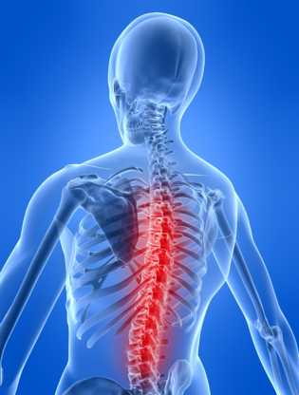
Common pregnancy-related issues
Low back pain
Hip pain
Abdominal weakness
Postural changes
Headaches
Changes in breathing
Bowel changes

Slide 6

Common postpartum, & related issues later in life
Low back pain
Hip pain
Abdominal weakness
Postural changes
Headaches
Changes in breathing
Bowel changes

Slide 7

Women’s Health issues postpartum, & later in life
Urinary / fecal incontinence
Dyspareunia
Pelvic pain
Pelvic support issues
Perineal pain
Anorectal pain

Slide 8
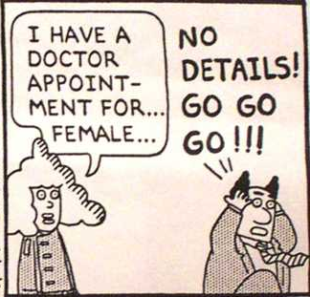
Women’s Health Issues…
Yes…We Do Have To Talk

Slide 9
Prenatal, postpartum and later in life…
Pain issues can sometimes be related to surgical scars from abdominal or pelvic interventions. Treatment to these restricted areas can often provide pain relief or resolution
Notes:
These numbers change higher or lower depending on the source you look at

Slide 10
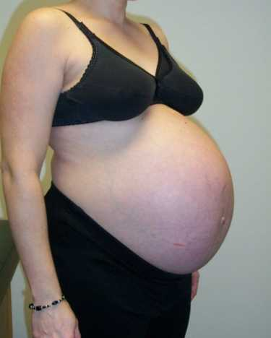
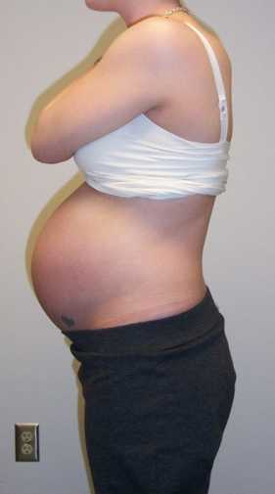
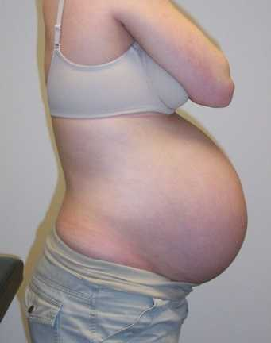
Pregnant Women are Different
Pictures were taken on the same day All three women due within one week of each other.

Slide 11
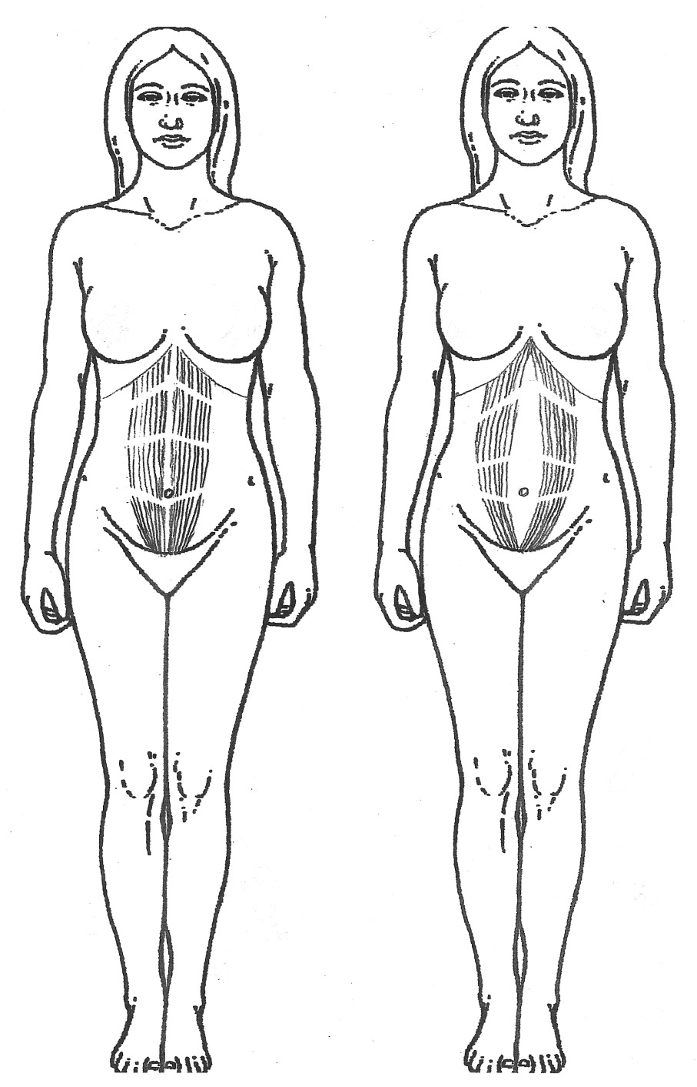
Diastasis recti
“If significant, it decreases the ability of the abdominal muscles to support the viscera and decreases the synergistic effect that the abdominals have with the pelvic floor muscles…Pain may be noted in the low back or pubis.”
Howard F, et al, Pelvic Pain Diagnosis and Management,
Philadelphia: Lippincott Williams & Wilkins, 2000

Slide 12
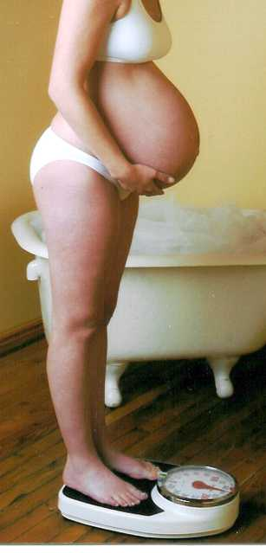
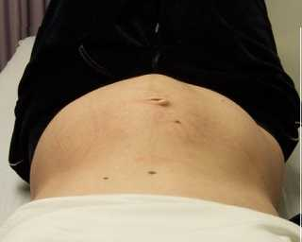
Common abdominal dysfunction
34 weeks, 1st pregnancy
23 weeks, 2nd pregnancy

Slide 13
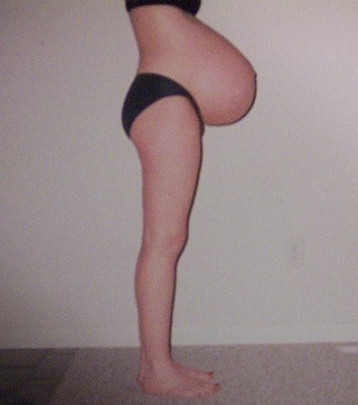
2nd Pregnancy
36 weeks
Severe diastasis recti
(5 finger widths) with abdominal muscle inhibition
This is an
incompetent abdomen
Notes:
Able to manage pain and dysfunction w/ exercises, binder early in pregnancy and mother to be support garment late in pregnancy

Slide 14
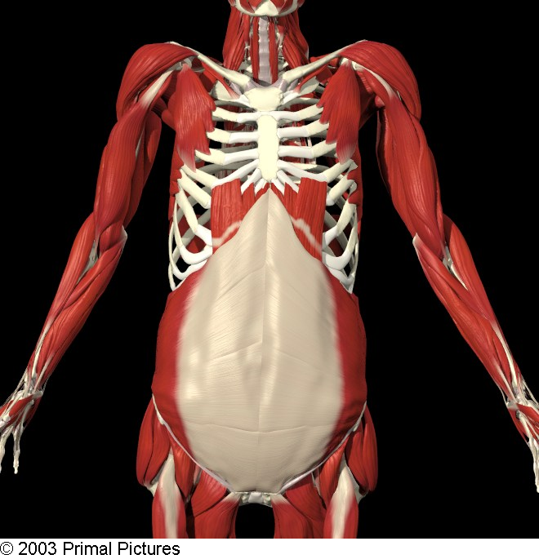
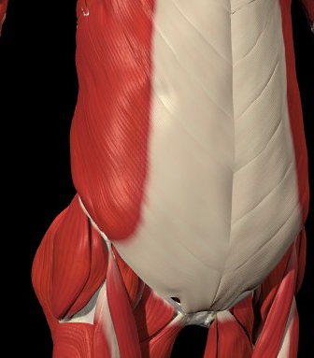
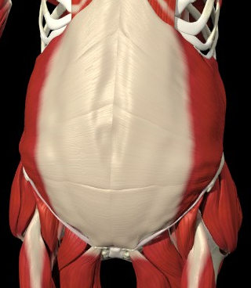
Diastasis Recti
The internal and external oblique muscles as well as the transversus abdominis muscle attach to the rectus sheath and ultimately, the linea alba (“white line”) anteriorly.
E.O.
TrAbd
I.O.

Slide 15
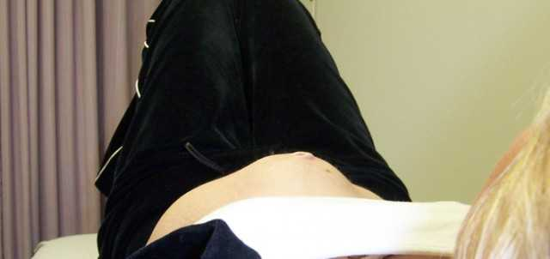
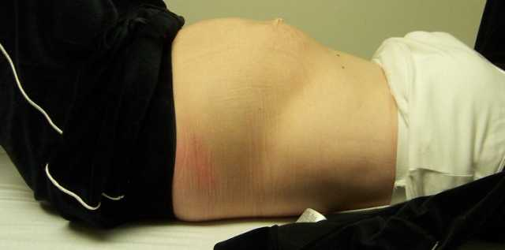
Large
diastasis recti

Slide 16


Slide 17
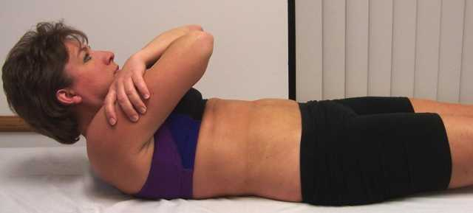
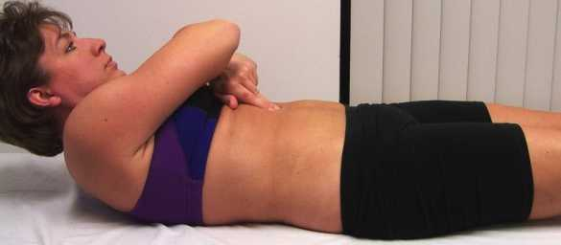
Diastasis Recti
Check for central bulge w/ partial curl up
Using 2 fingers check in 1” increments from sternum to pubis
Notes:
Also ask for curl up to clear scapulas from mat

Slide 18
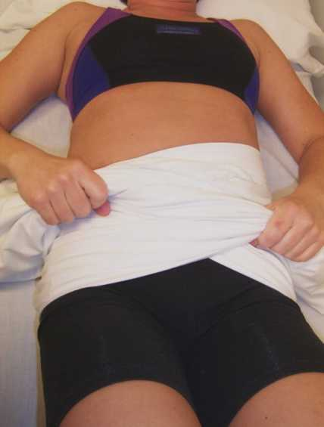
Diastasis Recti Closure
The Three “R”s
wRap the separated area and Pull the ends of the sheet
NOTE: Keeping one hand higher than the other helps keep the wrap pressure distributed properly

Slide 19
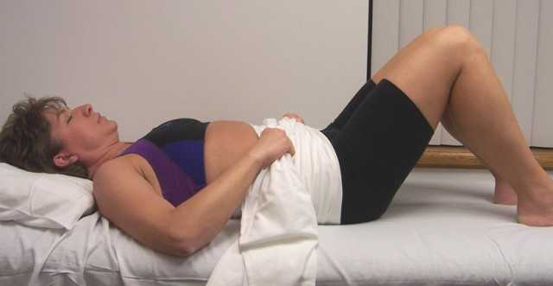
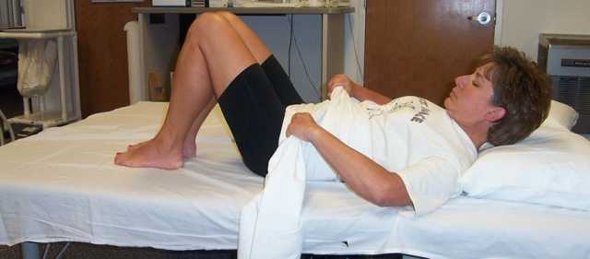
Diastasis Recti Closure
Raise the head to activate abs.
And Repeat
*Note: This can be done in the reclining position to decrease neck strain!

Slide 20
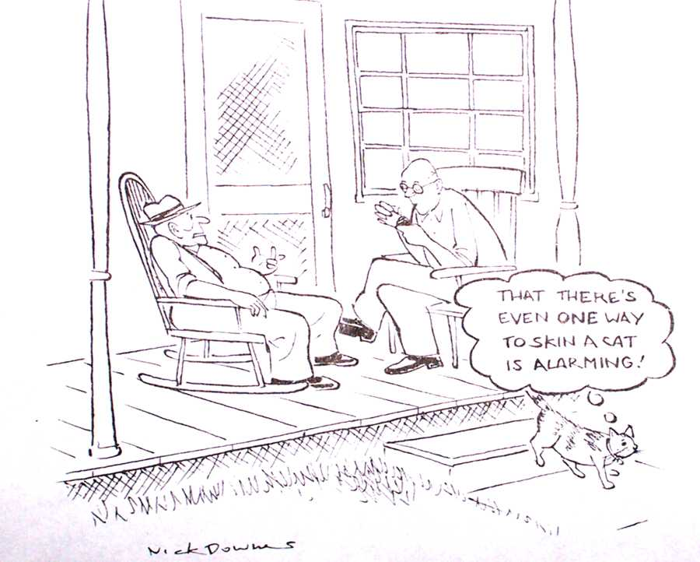
What to do if pt has neck
problems/pain?

Slide 21
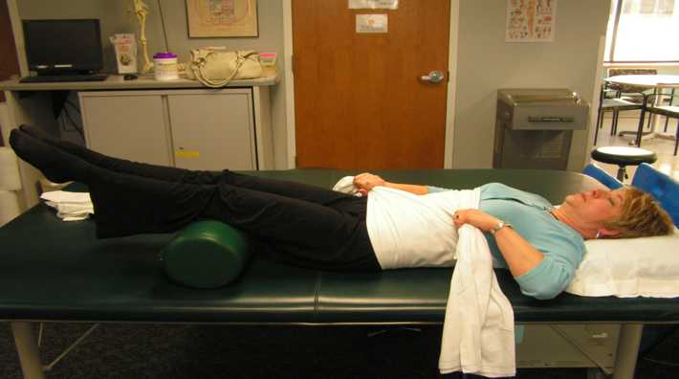
Diastasis Recti Closure
**Alternate method
Extend the supported lower legs until the abdominal mm are activated
Hold x 10 seconds,
Repeat x 10
Daily
*this method prevents possible neck discomfort

Slide 22
Diastasis Recti Closure
Exercise using the three “R”s
wRap, Raise and Repeat
Raise head or legs only and exhale during raise
Hold 10 seconds
Start with 5 to 10 reps
Do at least one time daily
…more is better

Slide 23
Diastasis Recti Closure
Protect the abdomen
Protect abdomen during cough or sneeze
Support abdomen during B.M.s
Avoid engaging abdominal obliques
TrAbd may also have a separating effect if worked vigorously
Notes:
Teach spouse how to support and assist during delivery

Slide 24
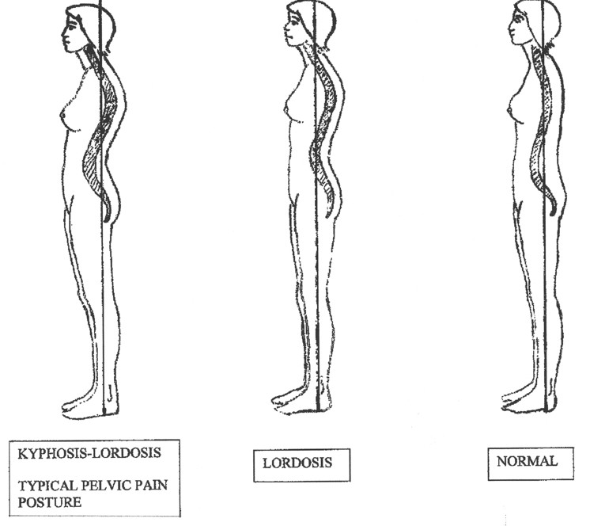
Pelvic Weakness Posture

Slide 25
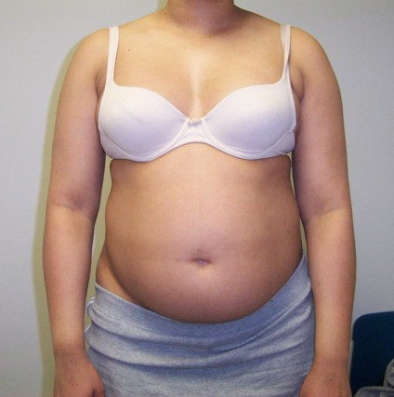
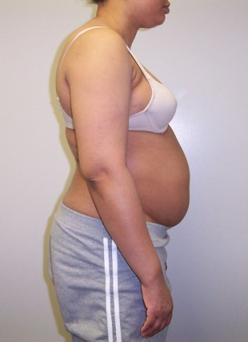
Pelvic Abdominal Dysfunction
First pregnancy; 16 weeks gestation
This is an incompetent abdomen with chronic postural dysfunction

Slide 26
What Does It Feel Like?
(Common patient complaints)
“I’ve tried to strengthen my abs but exercise doesn’t make me stronger and gives me back pain.”
“My posture is getting worse.”
“I have trouble completing B.M.s”

Slide 27
Pelvic Abdominal Dysfunction
A medical perspective of postural deficits and related pelvic weakness and pain sees posture as the driving force or causative agent in developing CPP.
When we look at this problem from an inverse perspective, it may truly be the abdominal and pelvic dysfunction which creates the negative postural changes.

Slide 28
Pelvic Abdominal Dysfunction
If you engage in an honest discussion with a woman of any age about their postural deficits, they will commonly tell you that they have tried to actively correct their posture and have been unable to do so.
In these women, posture markedly changes once the person has the tools that will allow them to “straighten up” and stay there.

Slide 29
Pelvic Abdominal Dysfunction
These changes have been apparent in patients whether the postural deficiencies have been present for relatively short periods of time, or for decades.
“Stand up straight” isn’t enough. Giving individuals the tools to reclaim normal pelvic and abdominal function works!

Slide 30
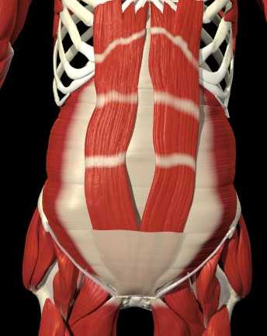
NEXT!
Learning how to “turn on” the abdominal muscles!

Slide 31
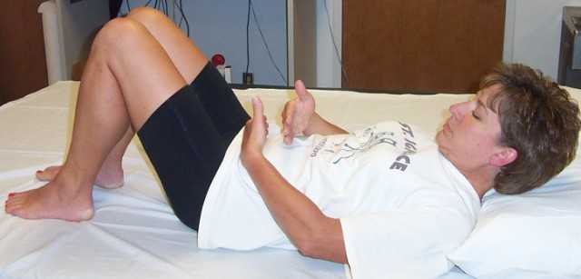
Abdominal Muscle Facilitation
Basic Technique With Cervical Flexion
(can be done in reclining to reduce possible neck discomfort)
neck!)

Slide 32
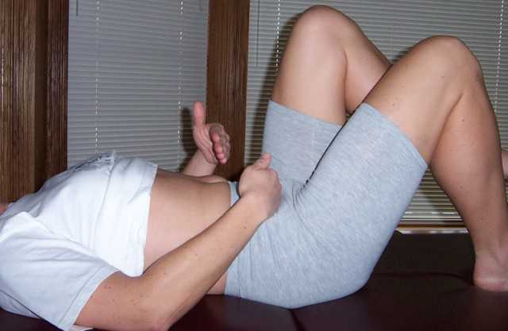
Abdominal Muscle Facilitation
Basic Lower Abdominal Progression
Tapping between the navel and the pubic bone
Marching with one foot always in contact with the floor

Slide 33
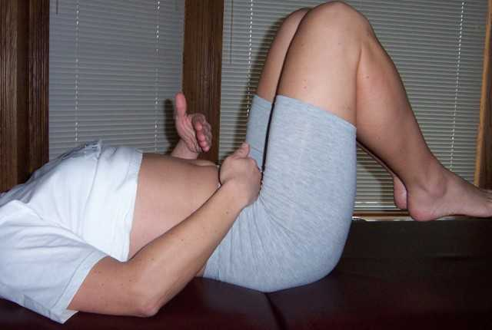
Abdominal Muscle Facilitation
Advanced Lower Abdominal Muscle Facilitation
Tapping between the navel and the pubic bone while bringing both knees up
Must be able to keep the back from arching for this progression

Slide 34
Pelvic floor exercises
Why?
How?
How many?

Slide 35

Pelvic floor exercises
WHY?
Prevent urinary incontinence
Prevent fecal incontinence
Prevent organ prolapse
Notes:
Also nocturnal freq, urgency,frequency, restore neuro reactions

Slide 36
Pelvic floor exercises
Why?
Strength / Control
Ability to relax

Slide 37
Pelvic floor exercises
How?
Primary Components
Contract and “lift” with muscles
around vagina
NOTE: Following is an approach to performing pelvic muscle exercises that the presenter has consistently found to yield excellent results.

Slide 38

Pelvic floor exercises
How?
Contracting muscles around the vagina
Critical components
Q: How can you know if muscles around the vagina are tightening?
A: Some women are confident and competent in learning this exercise via verbal instruction. Some women (especially when significant pelvic muscle weakness, or pain are present) require instruction via direct vaginal palpation providing verbal and tactile cues.

Slide 39

Pelvic floor exercises
How?
Contracting muscles around the vagina
Critical components
Q: What if you are pushing or bearing down?
A: This is ineffective and probably detrimental. To bear down or perform a valsalva maneuver may promote organ prolapse and create additional pelvic floor dysfunction. Sometimes women whose pelvic floor muscle are profoundly weak will do this instead of contracting the pelvic floor muscles.

Slide 40

Pelvic floor exercises
How?
Contracting muscles around the vagina
Critical components
Q: Isn’t stopping the urine flow enough information to do a correct “kegel”?
A: No women who use this as their only guideline for “kegels” are frequently doing an ineffective pelvic floor contraction.

Slide 41
Pelvic floor exercises
Critical components
Note: in clinical practice, we often see women who have learned to do a “kegel” by stopping their urine flow. Many of these women are starting and stopping their urine flow when urinating as their exercise.
This should be avoided as is potentially damaging to ones normal voiding reflexes.

Slide 42

Pelvic Floor Exercises
How many?
There is a wide range of recommendations from different practitioners.
Long term, the right number is the number that works for each individual.
Clinically, it seems that excellent technique in engaging the pelvic muscles is much more important than hold time or the number of repetitions performed.

Slide 43
Pelvic Floor Exercises
How many?
I generally recommend that female patients perform 25 sustained repetitions each day (hold time may vary but is based on competent hold time which is often 2 to 5 seconds) and 2-3 x 10 reps of “Quick flicks” (1 sec. hold / 2 sec. rest). This recommendation has consistently yielded excellent outcomes.
We are addressing slow twitch (2/3 of fibers) and fast twitch fibers (1/3 of fibers)

Slide 44
Kegel Home Program
The H.E.P. recommendation often looks like this:
3 second hold time
10 second rest time
5 repetitions at a time
20 to 25 total repetitions per day
2 X 10 sets of Quick Flicks /day

Slide 45

Kegel Home Program
I generally recommend this simple HEP protocol:
3 second hold time 10 second rest time
2-3 repetitions at a time immediately following voiding in the morning (from 1st void in the a.m. until noon)
10 repetitions of Quick Flicks after each void from Noon until bed-time
Simple protocol translates into success!

Slide 46
Other Considerations
Re: Incontinence treatment
“…preliminary findings suggest that RHR (Resisted Hip Rotation) exercises may be at least as effective as traditional PFMT methods, if not more so, in reducing the frequency of leaks for patients with Stress Urinary Incontinence.”
CSM 2012 SoWH Platform: Resisted Hip Rotation vs. P.F. Muscle Training in the Treatment of Female SUI, a Randomized Clinical trial: B. Jordre et al.

Slide 47
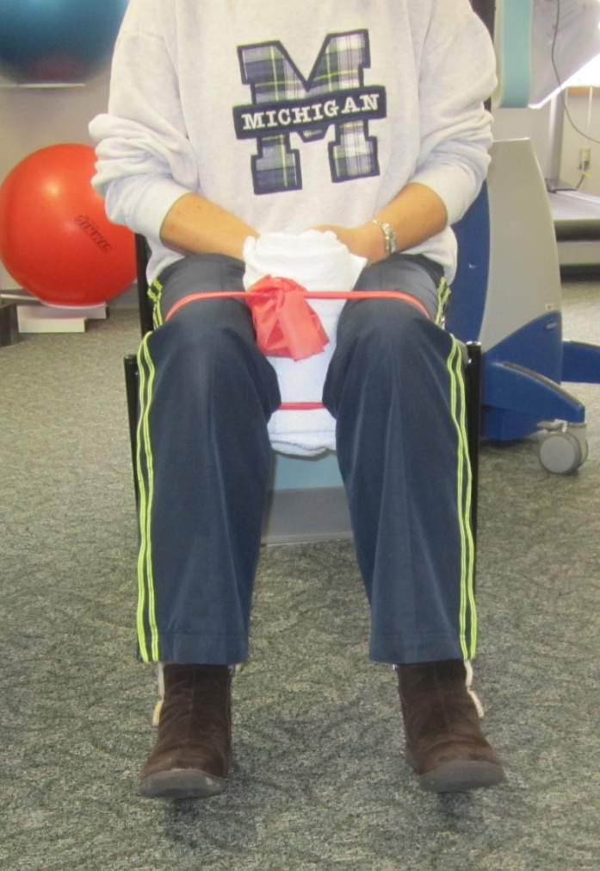
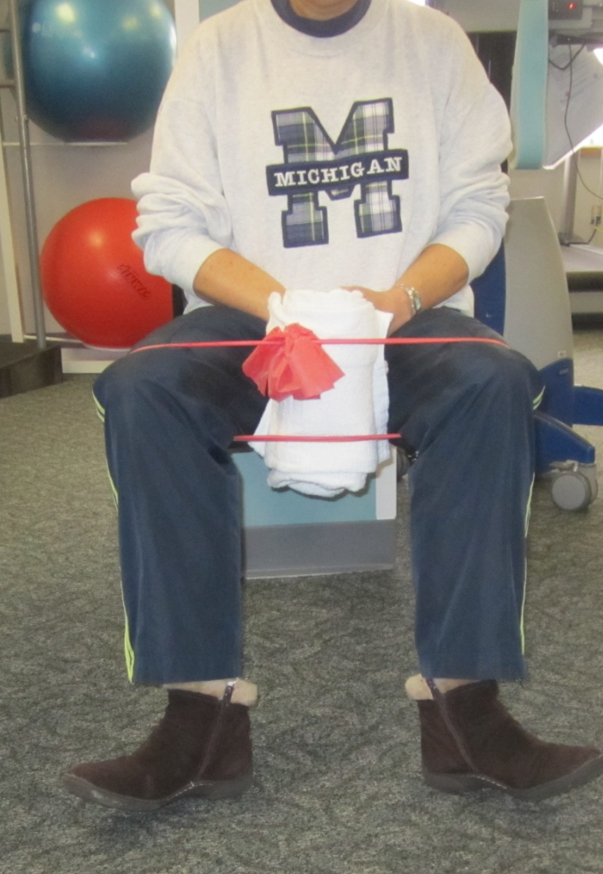
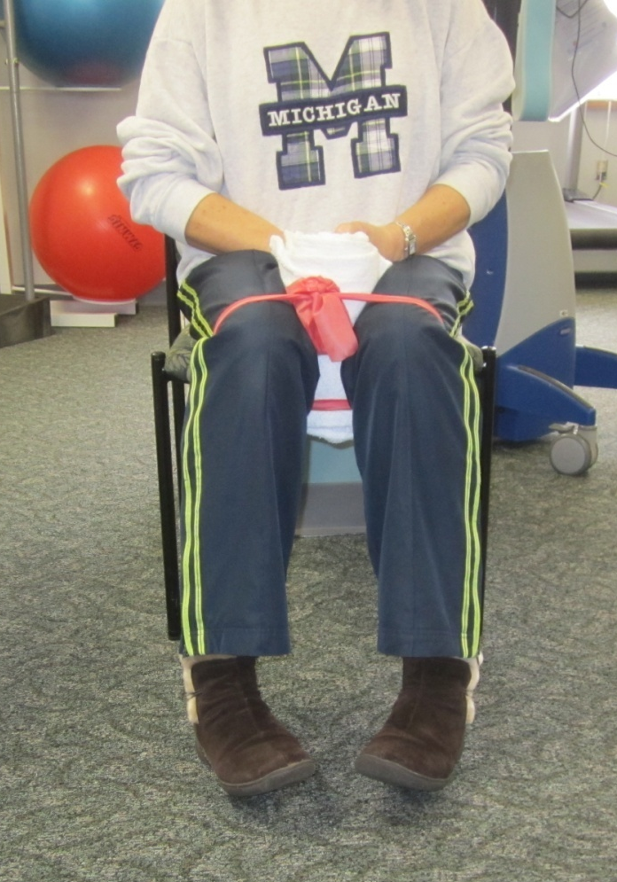
“Resisted Hip Rotation”
Pivot in on heels x 10 sec.
START
Pillow or towel roll between knees
&
band
around knees
BILAT HIP E.R.
Pivot out on heels x 10 sec.
BILAT HIP I.R.
Note: I usually see good success with 10 to 20 reps per day.

Slide 48
Pelvic floor exercises
Long term success
Have a strategy for success
Encourage a strong mind-body connection
Plan for the long term
Understand that pelvic floor muscle control empowers you!

Slide 49
Women’s Health PTs who address Perinatal Abdominal & pelvic issues
~~~~~~~~~~~~
Bruce LaBrecque RN, PT
Renue Physical Therapy
Bridgeport, MI

Slide 50

Knowledge is power!
Movement is Life!

